Slide 1
Graph Embeddings lecture-4 Course on Graph Neural Networks (Winter Term 22/23)
Prof. Dr. Holger Giese (holger.giese@hpi.de)
Christian Medeiros Adriano (christian.adriano@hpi.de) - “Chris”
Iqra Zafar (iqra.zafar@hpi.de )
Matthias Barkowski (matthias.barkowski@hpi.de )

Slide 2
Motivation
Data Preprocessing
Feature engineering
Prediction
Intervention
Collect data
Remove Outliers
Resolve Missing data
Build graphs
Network metrics
Similarity metrics
Clustering
Filtering
Node classification
Link prediction
Graph classification
Generative models
Self-Supervision
Minimize Selection Bias
Isolate Confounding
Estimate effects of interventions
Estimate impact of partial-observability (unmeasured confounders)
Systematize & Automate this step
Why would I want features that are independent of prediction tasks?
Learned Features might produce novel insightful descriptions of the networks
Learned Features might better generalize across tasks
I don’t know the prediction tasks yet

Slide 3




Node Embedding
N$ode_{G}$
E
A
F
B
H
C
G
D
$$Mapping Function Φ:G→ℝ^{n}$$
$$Feature_{j}$$
Unsupervised Learning
Learned features that represent node similarity
Similarity function is domain-specific
Find nodes by traversing the graph
$$N_{nodes }X N_{features}$$

Slide 4

Optimization Problem
Goal: Find the features that are the best predictors of the closest node i neighbors $Nr(i)$
$$\sum_{i∈N}{\log{P(N_{r}(i)|Φ_{i})}}$$
Objective Function:
(log-likelihood)
Neighbors of node i
Features of node i
How to select neighbors?
Traverse the graph

Slide 5
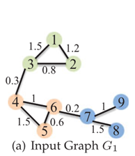
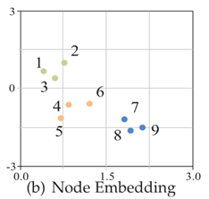
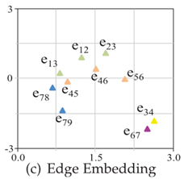
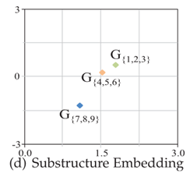
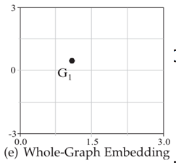
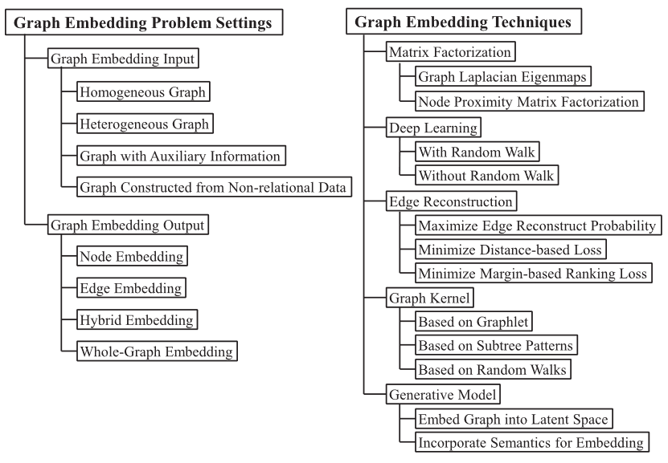
Types of embeddings
Sources
Cai, H., Zheng, V. W., & Chang, K. C. C. (2018). A comprehensive survey of graph embedding: Problems, techniques, and applications. IEEE Transactions on Knowledge and Data Engineering, 30(9), 1616-1637
Perozzi, B., Al-Rfou, R., and Skiena, S. (2014) "Deepwalk: Online learning of social representations." Proceedings of the 20th ACM SIGKDD international conference on Knowledge discovery and data mining.
Grover, A., & Leskovec, J. (2016) "node2vec: Scalable feature learning for networks." Proceedings of the 22nd ACM SIGKDD international conference on Knowledge discovery and data mining.
Qiu, Jiezhong, et al. (2018) "Network embedding as matrix factorization: Unifying deepwalk, line, pte, and node2vec." Proceedings of the Eleventh ACM International Conference on Web Search and Data Mining.
Grohe, M., (2020). "word2vec, node2vec, graph2vec, x2vec: Towards a theory of vector embeddings of structured data." Proceedings of the 39th ACM SIGMOD-SIGACT-SIGAI Symposium on Principles of Database Systems. 2020.

Slide 6
Topics
Softmax
DeepWalk
Node2Vec
Graph Embeddings

Slide 7

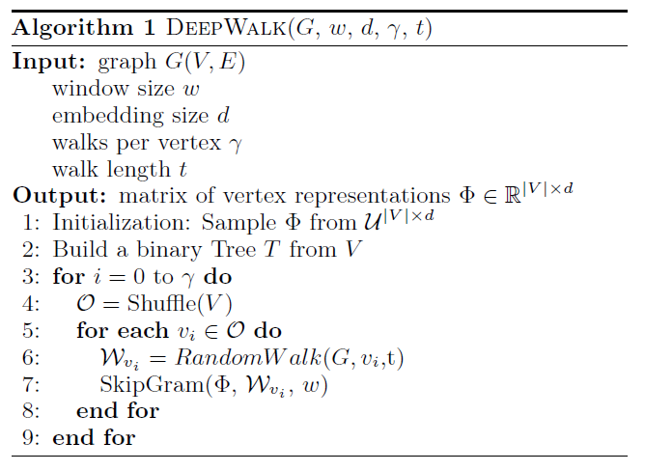
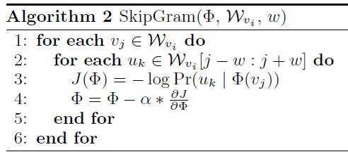


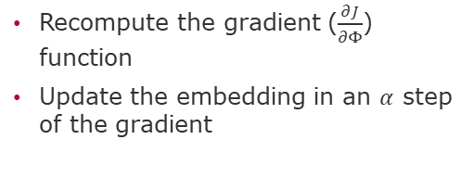
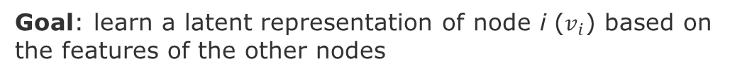
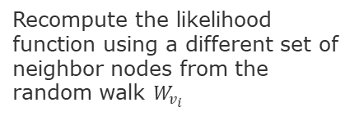
Random Walks [Perozzi, Al-Rfou & Skiena 2014]
Goal: learn a latent representation of node i ($v_{i}$) based on the features of the other nodes
, where $Φ\left(v_{i}\right)$is a feature vector of node i
Recompute the likelihood function using a different set of neighbor nodes from the random walk $W_{v_{i}}$
Recompute the gradient ($\frac{∂J}{∂Φ}$) function
Update the embedding in an $α$ step of the gradient
On random walk for each node $v_{i}$
Update the embedding of node $v_{i}$
Perozzi, B., Al-Rfou, R., and Skiena, S. (2014) "Deepwalk: Online learning of social representations." Proceedings of the 20th ACM SIGKDD international conference on Knowledge discovery and data mining

Slide 8





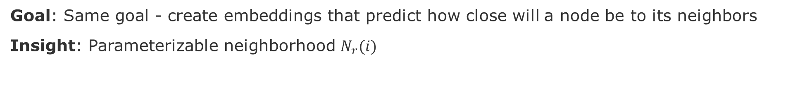
Node2Vec [Grover & Leskovec 2016]
Goal: Same goal - create embeddings that predict how close will a node be to its neighbors
Insight: Parameterizable neighborhood $N_{r}(i)$
$$W=\left\{\begin{matrix}Nodes & Visiting Weight & \\ E & 1/q & \\ \begin{aligned}D \\ C \\ B\end{aligned} & \begin{aligned}1/p \\ 1/q \\ 1\end{aligned} & \end{matrix}\right\}$$
E
1/q
E
A
A
1
F
F
B
1/q
B
H
H
1/p
C
C
G
G
D
D
Types of Walks
Parameters
q: Probability of doing a Breadth First Search (BFS) versus Depth First Search (DFS) Walk:
q>1 → BFS, whereas q<1 → DFS
p: likelihood of immediately revisiting a node in the walk
p > max(q, 1)) →less likely to sample an already visited node in the following two steps.
Breadth First Search (local view)
Depth First Search (global view)
Revisit walks (revisit nodes)
Grover, A., & Leskovec, J. (2016) "node2vec: Scalable feature learning for networks." in 22nd ACM SIGKDD intl. conf. on Knowledge discovery and data mining.

Slide 9
Node Embedding drawback
"... vector generated from the embedding vectors of its endpoints (nodes) cannot preserve the complete properties of this edge. Thus, the analysis tasks on edges, such as link prediction, cannot achieve the best performance based on these indirect approaches.“ [Wang 2020]
Changping Wang, et al., 2020. Edge2vec: Edge-based Social Network Embedding. ACM Trans. Knowl. Discov. Data 14, 4, 45.

Slide 10
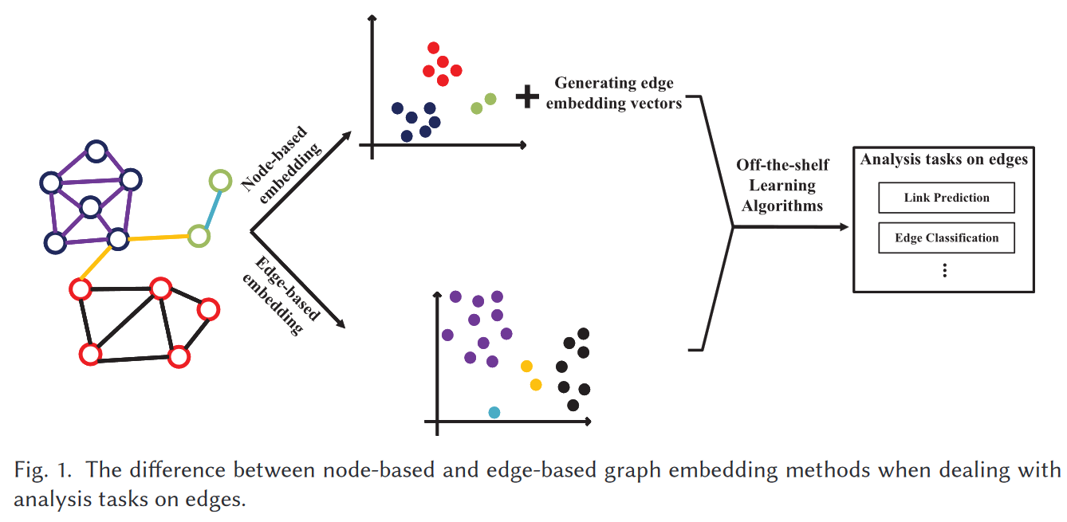
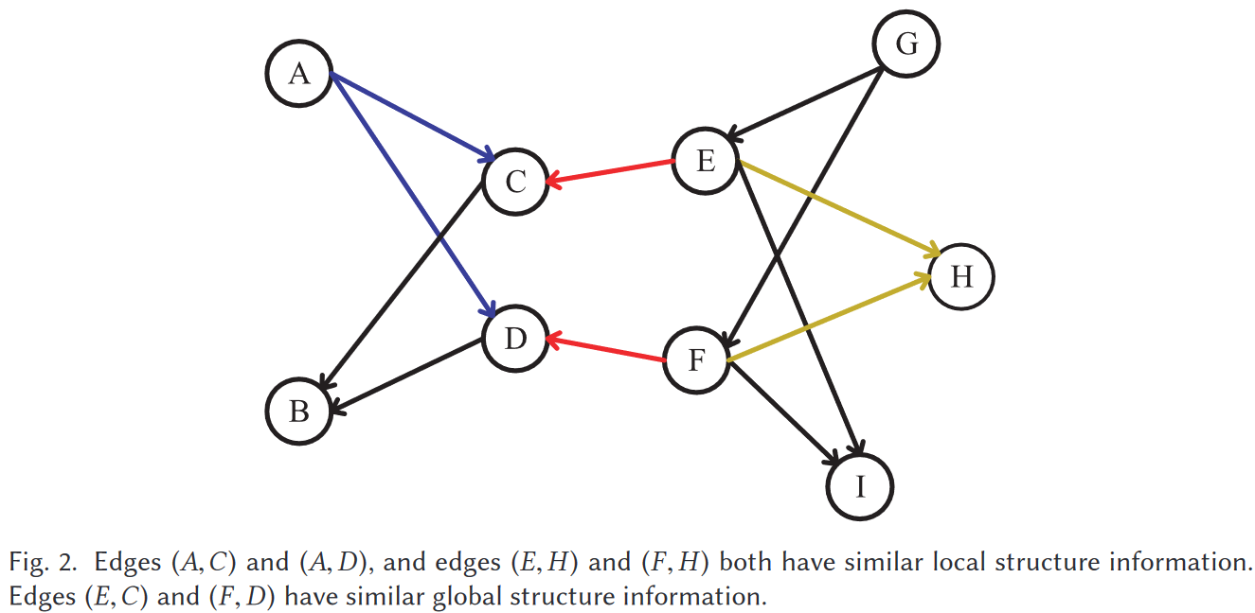
Edge2Vec [Wang 2020]
“… embedded edges express edge proximity w.r.t. the structure information”
Drawback edge-based graph embedding can be difficult to scale because #edges>>#nodes. However, in social networks, the average degree of nodes is bounded [Fei 2014]."
Scalability solution for preserving both the local and the global structure information - combine deep autoencoder [Salakhutdinov & Hinton 2009] and Skip-gram model [Mikolov, Sutskever, et al., 2013] with a specialized deep neural network architecture.
Changping Wang, et al., 2020. Edge2vec: Edge-based Social Network Embedding. ACM Trans. Knowl. Discov. Data 14, 4, 45
Fei Tian, et al., 2014. Learning deep representations for graph clustering. In Proceedings of the 28th AAAI.1293–1299.
Ruslan Salakhutdinov and Geoffrey E. Hinton. 2009. Semantic hashing. International Journal of Approximate Reasoning 50, 7.
Thomas Mikolov, Ilia Sutskever, et al., 2013, Distributed representations of words and phrases and their compositionality. In NeurIPS.
Notes:
Quoting {Wang 2020] “Figure 1 shows the difference between node-based and edge-based graph embedding meth- ods when dealing with analysis tasks on edges. The node-based methods focus on the nodes and their corresponding properties, e.g., the node proximity [30]. The embedding result can be used for analysis tasks on edges through generating edge embedding vectors. However, edge-based graph embedding methods can directly embed edges in the network by focusing on the properties w.r.t. edges (e.g., the edge proximity from the aspect of structure information).”
Changping Wang, et al., 2020. Edge2vec: Edge-based Social Network Embedding. ACM Trans. Knowl. Discov. Data 14, 4, 45
Fei Tian, et al., 2014. Learning deep representations for graph clustering. In Proceedings of the 28th AAAI.1293–1299.
Ruslan Salakhutdinov and Geoffrey E. Hinton. 2009. Semantic hashing. International Journal of Approximate Reasoning 50, 7.
Thomas Mikolov, Ilia Sutskever, et al., 2013, Distributed representations of words and phrases and their compositionality. In NeurIPS.

Slide 11
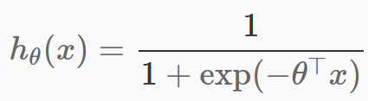
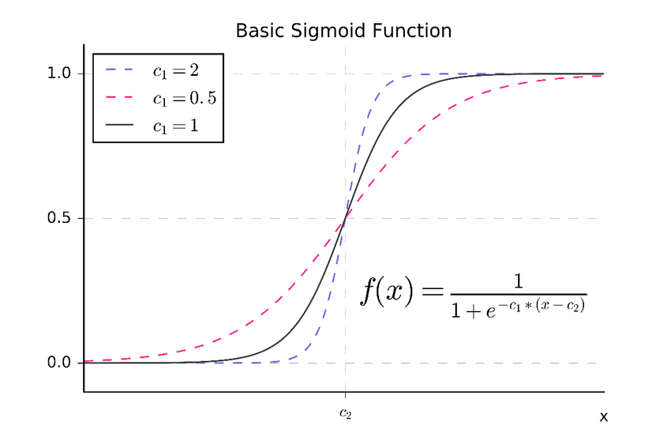
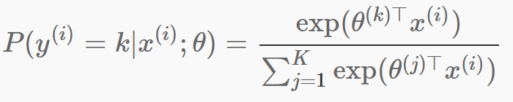
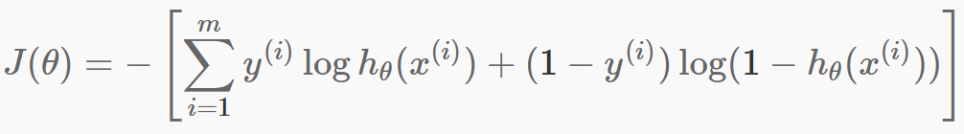
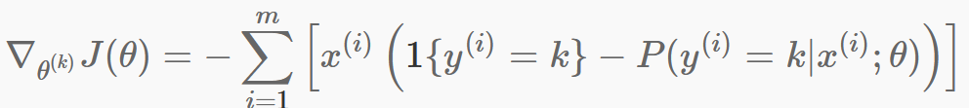

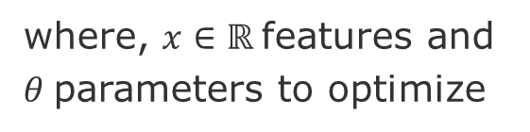
Softmax [1]
where, $x∈ℝ$features and $θ$parameters to optimize
where, $y$are the classes of$x$
Cost function $J$
Gradient of $J$
[1] http://ufldl.stanford.edu/tutorial/supervised/SoftmaxRegression/

Slide 12
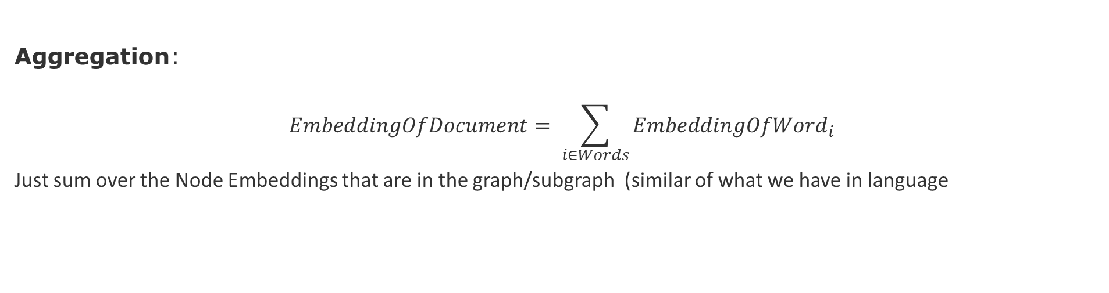
Graph Embedding Methods
Aggregation:
$$EmbeddingOfDocument= \sum_{i∈Words}{EmbeddingOfWord_{i}}$$
Just sum over the Node Embeddings that are in the graph/subgraph (similar of what we have in language
Virtual node:
Create a virtual that connects all nodes in a subgraph. Runs node embeddings for all nodes in the subgraph and the virtual node. The embedding of the virtual node will be the embedding of the subgraph.
V2
V1
E
A
B
F
C
D

Slide 13
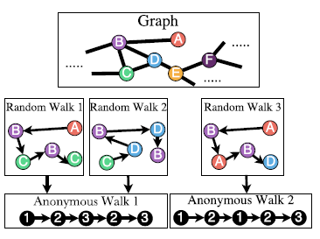
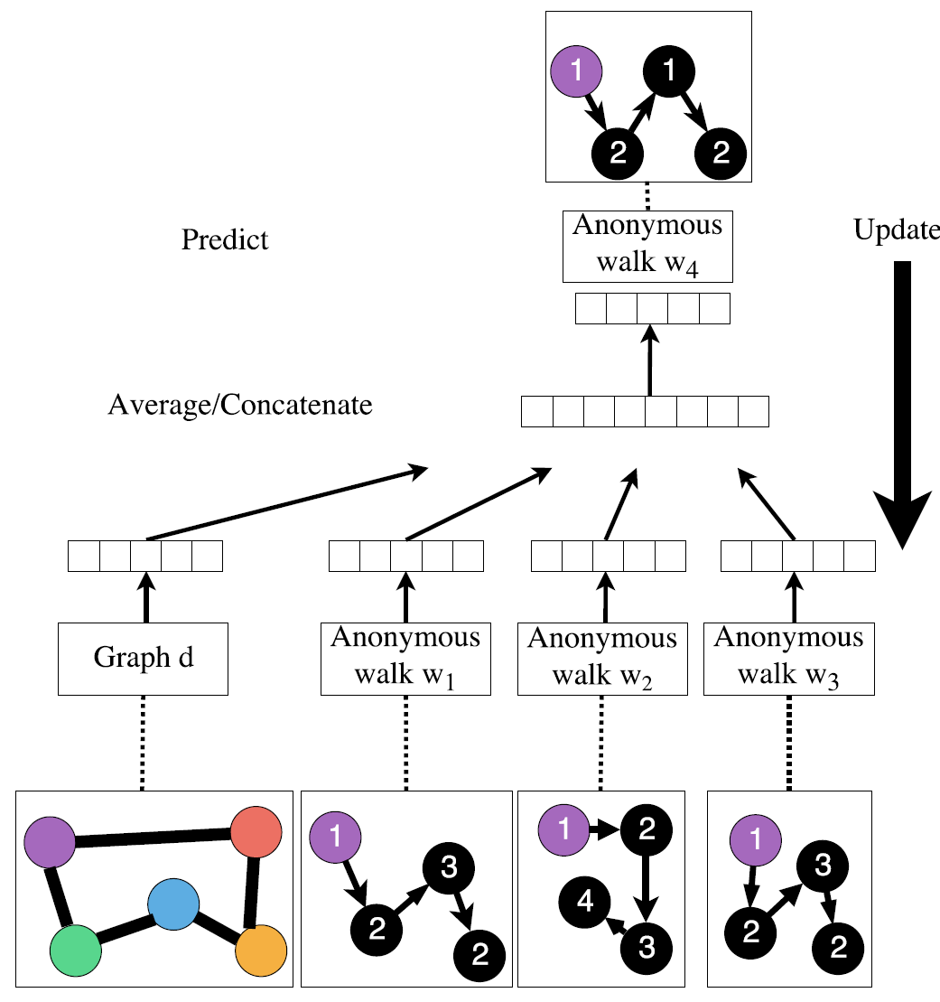
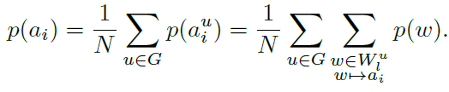
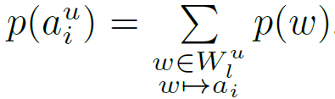


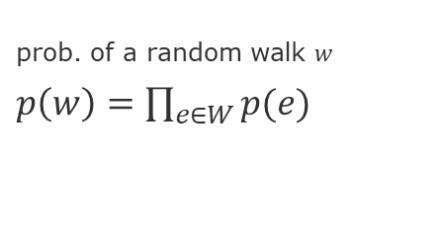

Graph Embedding Methods – Anonymous Walks
Probability of a walk $a_{i}$
Goal: predict $W_{4}$by its surrounding context walks (${w_{1},}_{ }…,w_{3}$) and a graph vector $d$.
prob. of a random walk $w$
$p\left(w\right)=\prod_{e∈W}{p(e)}$
prob. of anonymous walk $a_{i}^{u}$
keep track of the order in which the nodes were visited.
Advantages
Task-independent
Scalable
Ivanov, S., & Burnaev, E. (2019). Anonymous walk embeddings. ICML, arXiv preprint arXiv:1805.11921.

Slide 14
Current and Near Future Tasks
Study three metrics Temporal Graph Metrics
Study three papers on Graph Embeddings for Spatio-Temporal Graphs
See Zotero spatio-temporal graphs>embeddings>graph embeddings
Near Future
Study of three Generative models for Spatio-Temporal Graphs
Write down the summaries in the report template (suggested data November 11)

Slide 15
END

Slide 16
Abstract format
[Context] The context explains the domain and the motivation for the research, for instance, a difficulty, cost, risk, or any other impact that people/society/business/environment face.
[Problem] The problem is a general question that if answered would contribute to mitigate or better understand the motivation stated before. In our particular case, problems should framed as prediction and intervention problem, i.e., how to predict an outcome and how to use this prediction to intervene in the process that generates the data. Try to convey three main ideas:
what is the problem?
why is it important?
why is it difficult?
[Investigation approach] The Investigation approach will describe briefly the data (what is it, how it was collected) and the prediction methods (what type of predictions, why are they difficult to produce).

